Slide 1
Advanced Features and Application Case Studies
Brief peek at other features
© 2018 L. V. Kale at the University of Illinois Urbana

Slide 2
Control Flow within Chare
Structured dagger notation
Provides a script-like language for expressing dag of dependencies between method invocations and computations
Threaded entry methods
Allows entry methods to block without blocking the PE
Supports futures and
Ability to suspend/resume threads

Slide 3
Advanced Concepts
Priorities
Entry method tags
Quiescence detection
LiveViz: visualization from a parallel program
CharmDebug: a powerful debugging tool
Projections: Performance Analysis and Visualization, a workhorse tool for Charm++ developers
Messages (instead of marshalled parameters)
Processor-aware constructs:
Groups: like a non-migratable chare array with one element on each “core”
Nodegroups: one element on each process

Slide 4
Saving Cooling Energy
Easy: increase A/C setting
But: some cores may get too hot
So, reduce frequency if temperature is high (DVFS)
Independently for each chip
But, this creates a load imbalance!
No problem, we can handle that:
Migrate objects away from the slowed-down processors
Balance load using an existing strategy
Strategies take speed of processors into account
Implemented in experimental version
SC 2011 paper, IEEE TC paper
Several new power/energy-related strategies
PASA ‘12: exploiting differential sensitivities of code segments to frequency change

Slide 5
PARM: Power Aware Resource Manager
Charm++ RTS facilitates malleable jobs
PARM can improve throughput under a fixed power budget using:
Overprovisioning (adding more nodes than conventional data center)
RAPL (capping power consumption of nodes)
Job malleability and moldability

Slide 6
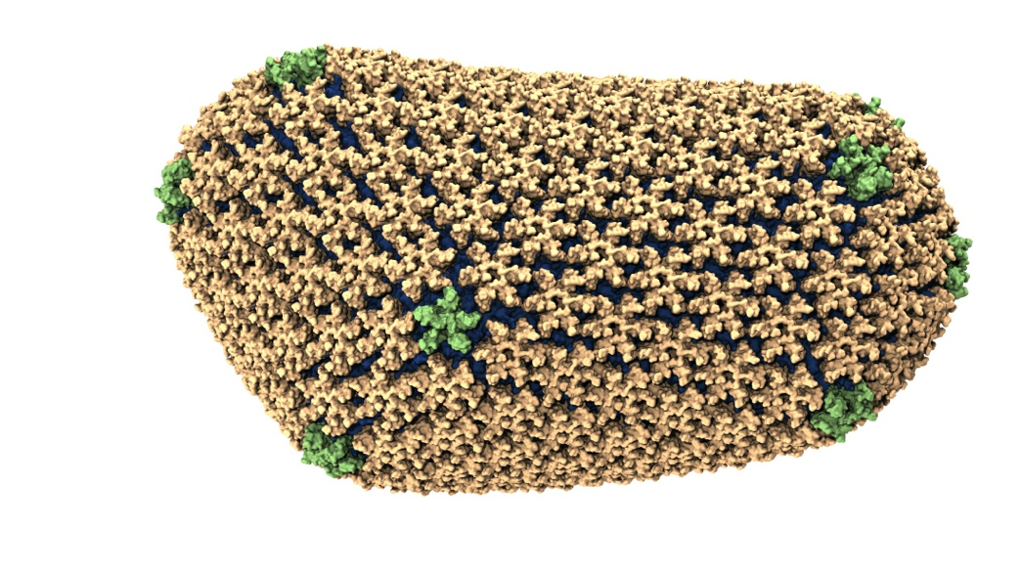
NAMD: Biomolecular Simulations
Collaboration with K. Schulten
With over 70,000 registered users
Scaled to most top US supercomputers
In production use on supercomputers and clusters and desktops
Gordon Bell award in 2002
Determination of the structure of HIV capsid by researchers including Prof Schulten

Slide 7
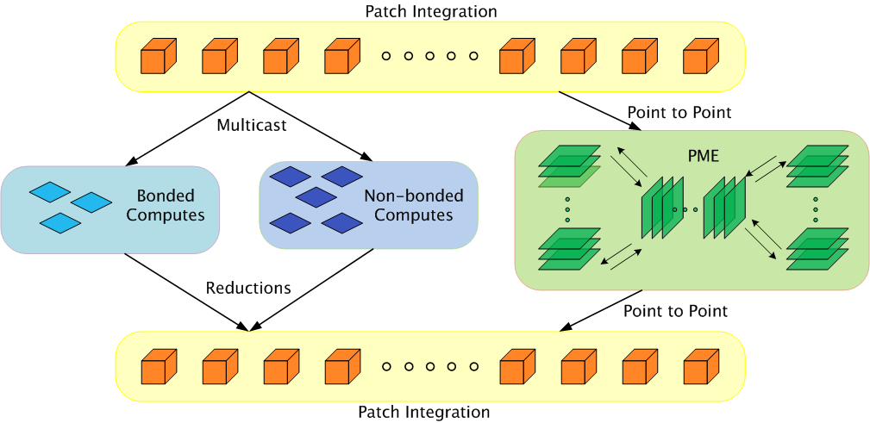
Parallelization Using Charm++

Slide 8
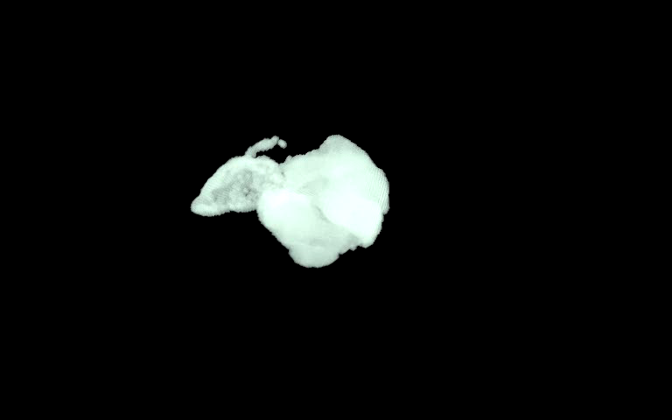
ChaNGa: Parallel Gravity
Evolution of Universe and Galaxy Formation
Collaborative project (NSF)
With Tom Quinn, Univ. of Washington
Gravity, gas dynamics
Barnes-Hut tree codes
Oct tree is natural decomp
Geometry has better aspect ratios, so you “open” up fewer nodes
But is not used because it leads to bad load balance
Assumption: one-to-one map between sub-trees and PEs
Binary K-D trees are considered better load balanced
With Charm++: use Oct-Tree, and let Charm++ map subtrees to processors

Slide 9
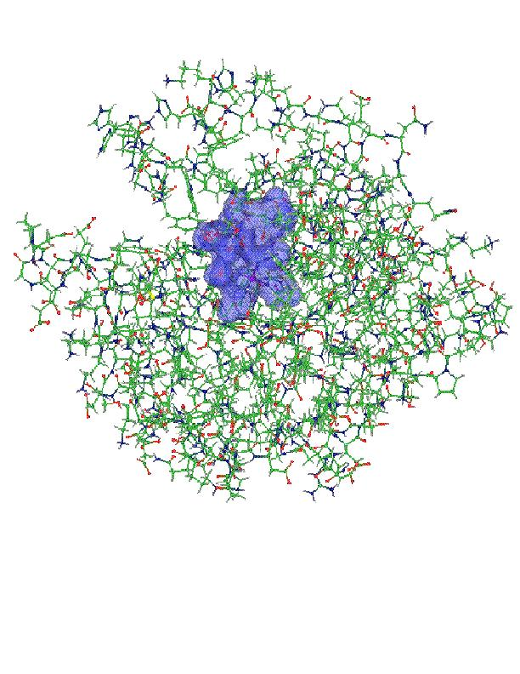
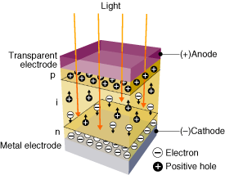
OpenAtom:
On the fly ab initio molecular dynamics on the ground state surface with instantaneous GW-BSE level spectra
PIs: G.J. Martyna, IBM; S. Ismail-Beigi, Yale; L. Kale, UIUC;
Team: Q. Li, IBM, M. Kim, Yale; S. Mandal, Yale;
E. Bohm, UIUC; N. Jain, UIUC; M. Robson, UIUC; E. Mikida, UIUC; P. Jindal, UIUC; T. Wicky, UIUC.
Light in
1

Slide 10
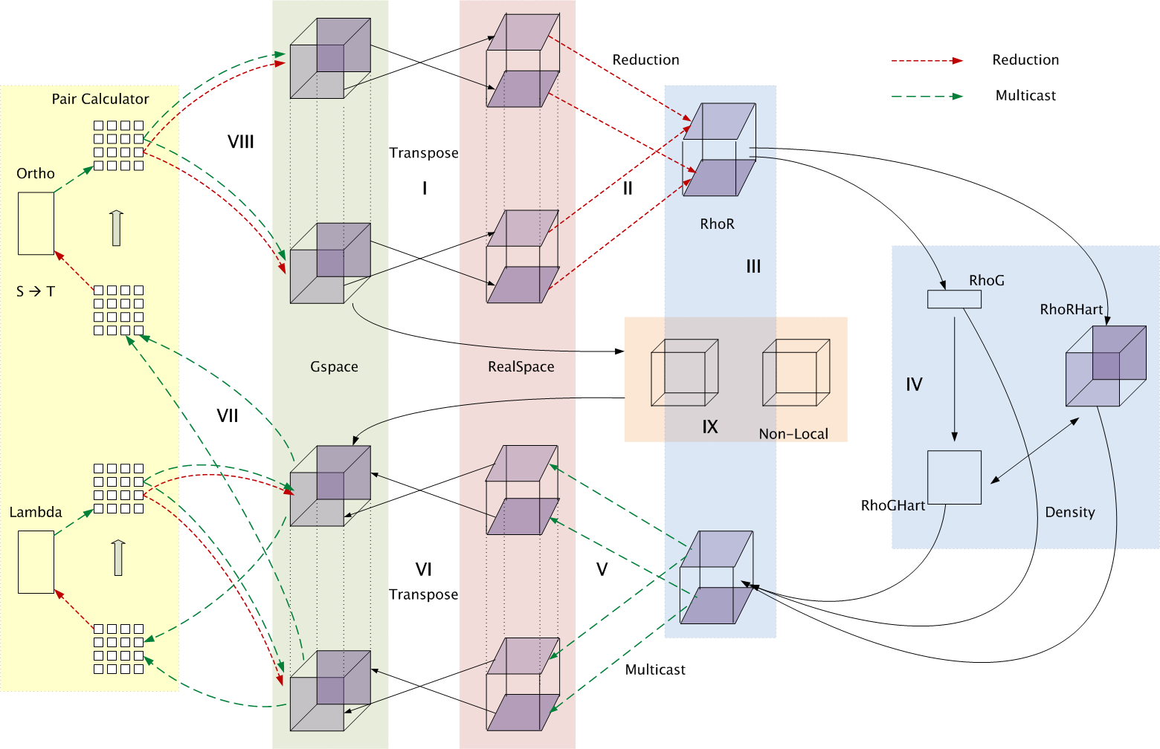
Decomposition and Computation Flow

Slide 11
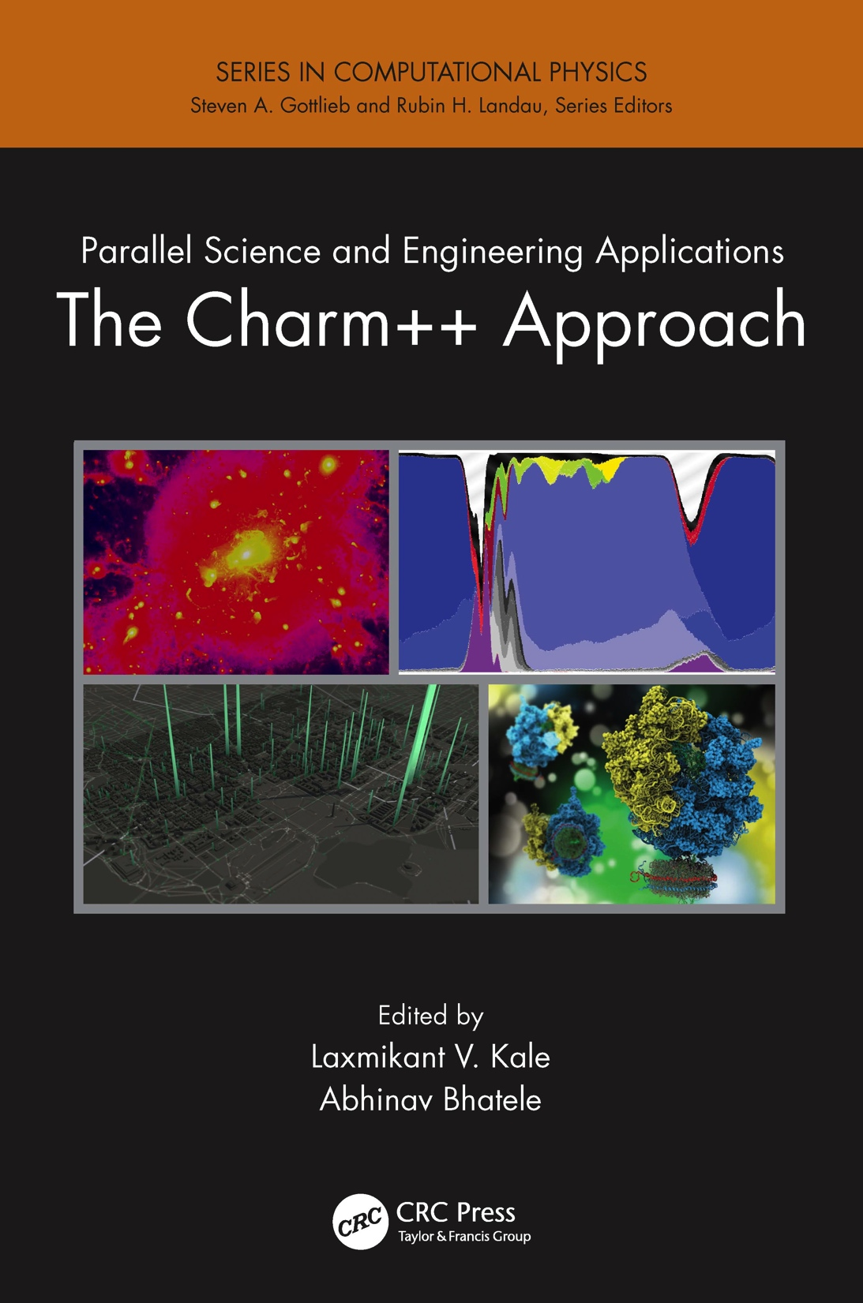
Describes seven major applications developed using Charm++
More info on Charm++:
http://charm.cs.illinois.edu
including the MiniApps

Slide 12
MiniApps
Available at: http://charmplusplus.org/miniApps/
MiniApp | Features | Machine | Max cores
AMR | Over-decomposition, Custom array index, Message priorities, Load balancing, Checkpoint restart | BG/Q | 131,072
LeanMD | Over-decomposition, Load balancing, Checkpoint restart, Power awareness | BG/P BG/Q | 131,072 32,768
Barnes-Hut (n-body) | Over-decomposition, Message priorities, Load balancing | Blue Waters | 16,384
LULESH 2.02 | AMPI, Over-decomposition, Load balancing | Hopper | 8,000
PDES | Over-decomposition, Message priorities, TRAM | Stampede | 4,096

Slide 13
More MiniApps
MiniApp | Features | Machine | Max cores
1D FFT | Interoperable with MPI | BG/P BG/Q | 65,536 16,384
Random Access | TRAM | BG/P BG/Q | 131,072 16,384
Dense LU | SDAG | XT5 | 8,192
Sparse Triangular Solver | SDAG | BG/P | 512
GTC | SDAG | BG/Q | 1,024
SPH |  | Blue Waters | -

Slide 14
More information
A lecture series with instructional material coming soon
http://charmplusplus.org/ (under “Learn”)
See also “Exercises” at the same link
MiniApps (source code):
http://charmplusplus.org/miniApps/
Research projects, papers, etc.
http://charm.cs.illinois.edu/
Commercial support:
https://www.hpccharm.com/

